Slide 1
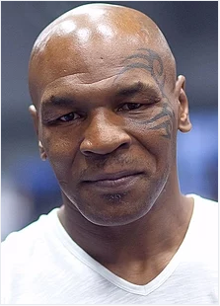
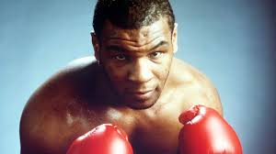
Mike “Iron” TYSON
Birth and early life
Rise to stardom
Undisputed champion
After Douglas
Controversy and upset
Born in 1966 and holds the record for winning a major heavyweight boxing title at the age of 20 years
After a series of victories, he had to withdraw from the undisputed championship due injuries on his rib cage incurred during training.
Made his debut at a young age of 18 winning 15 bouts in his first year. Won 26 of his 28 fights through knock outs and TKO
Apart from contractual issues, personal problems like divorce further had a great impact on his professional career
His consistent performances made him defeat great opponents in style that he featured in Nintendo’s game “Punch Out” that sold more than a million copies
He later was charged of rape and sentenced to 6 years in prison with an additional 4 years for probation. It was later discovered he suffered from drug addiction something that caused his bankruptcy.
The Ring Magazine ranked him 14th in The Greatest Heavyweights of All Time in 1998. He was the inducted to the International Boxing Hall of Fame in 2011.
Even though he served his term for the crimes committed, Tyson deserves a place of honor with the greatest of tragic heroes

